Slide 1
Has The Gaming Market Come and Gone?
By Gordon McIntire

Slide 2
The Problem:
The video games market is expected to drop in 2021 for the first time since the firm began tracking in 2012. How is this prediction?

Slide 3
The Solution:
Perform Time-Series Analysis on the global sales of console video games, building models to forecast sales as well as future volatility.

Slide 4
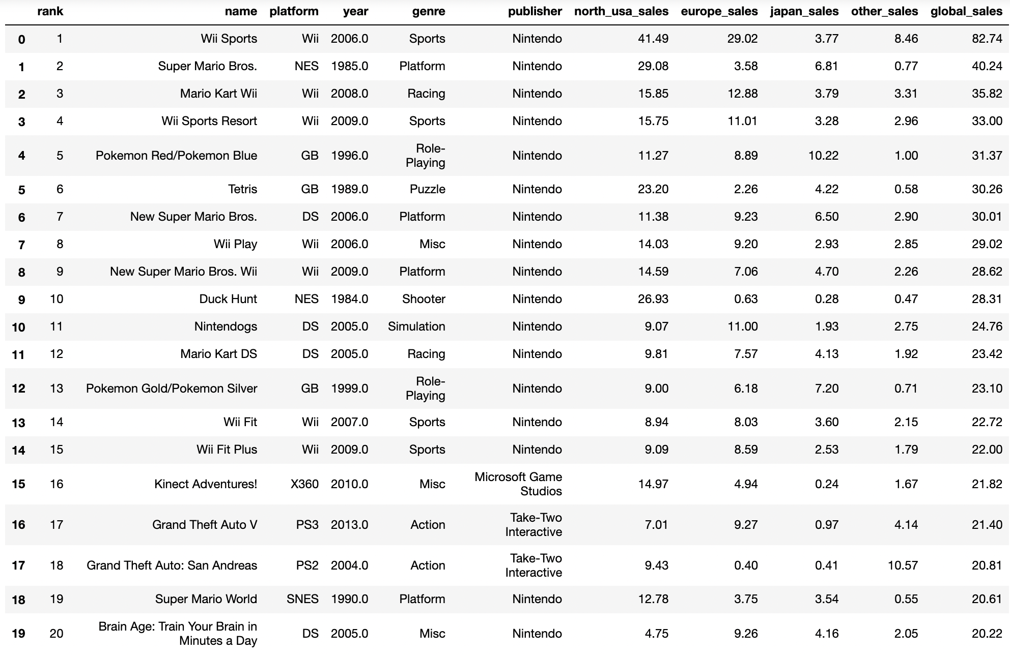
Raw Data

Slide 5
Data Information
The dataset I’m working with contains a list of video games with sales greater than 100,000 copies. It was generated by a scrape, based on BeautifulSoup using Python, of vgchartz.com.
There are 16,598 records, each containing the fields:
Rank - Ranking of overall sales
Name - The games name
Platform - Platform of the games release (i.e. PC,PS4, etc.)
Year - Year of the game's release
Genre - Genre of the game
Publisher - Publisher of the game
NA_Sales - Sales in North America (in millions)
EU_Sales - Sales in Europe (in millions)
JP_Sales - Sales in Japan (in millions)
Other_Sales - Sales in the rest of the world (in millions)
Global_Sales - Total worldwide sales

Slide 6
Data Wrangling
I started by dropping all null values. I then converted the year column to a datetime for it to work correctly in a time series, and combined it with global sales, my target variable.

Slide 7
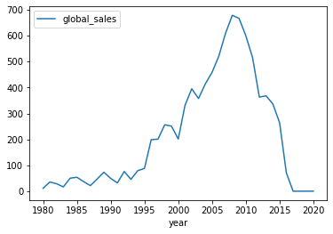
Global Video Game Sales
One can spot a steep upwards trend, over the past 25 years especially, followed by a similarly steep drop-off.

Slide 8
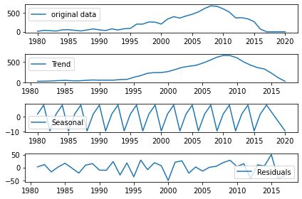
Modeling: Decomposition
To understand the yearly global sales data better, I used the decompose function, breaking the time series data into trend, seasonality, and noise.

Slide 9
KPSS Test for Stationarity
I tested whether it was stationary using a KPSS test. The resulting p-value was over 0.05, which meant the data was stationary and suitable for the next step.
10% : 0.347
5%. : 0.463
2.5% : 0.574
1% : 0.739

Slide 10
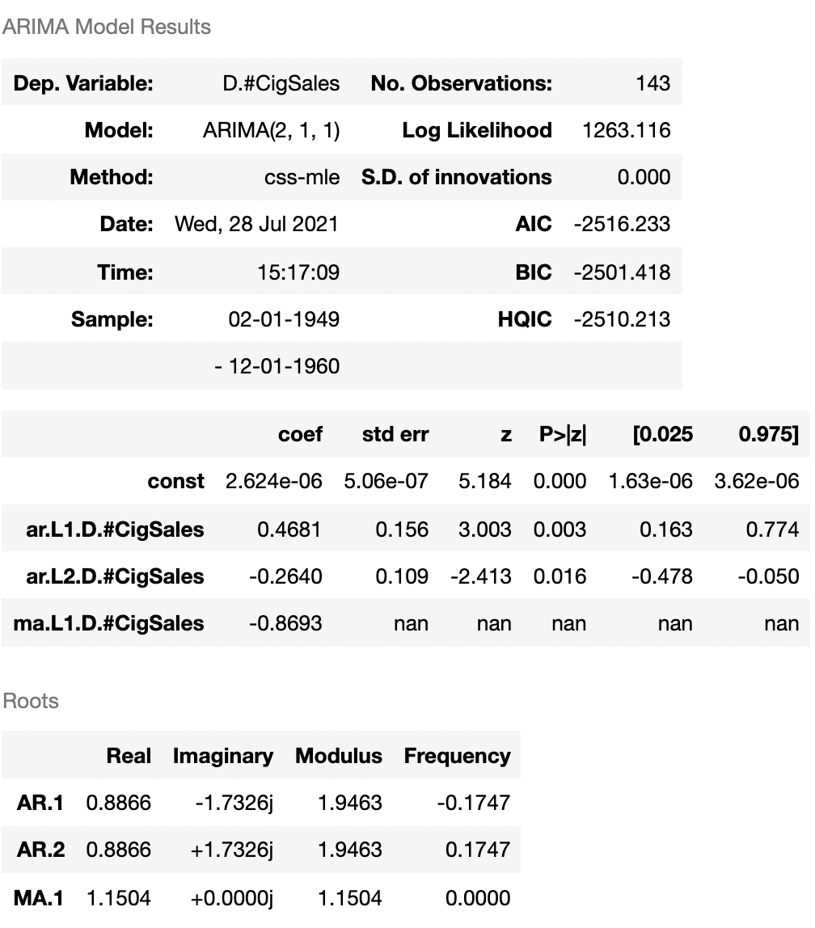
ARIMA Model
Once I knew the data was stationary, I then wanted to use an ARIMA model to forecast, which required finding the best parameters. To do this I made functions to find the MSE of a single ARIMA model and try different models with different parameters. Eventually I obtained the optimum model ARIMA model for my data.

Slide 11
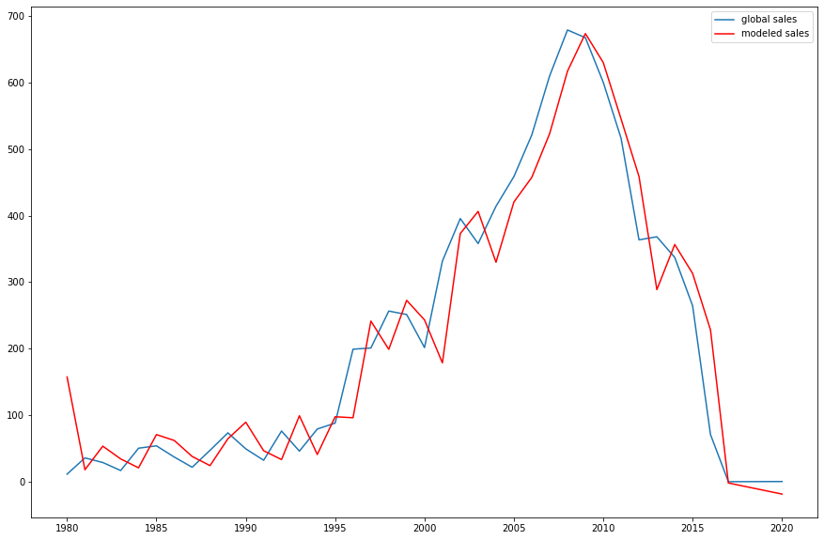
Original dataset plotted against my model

Slide 12
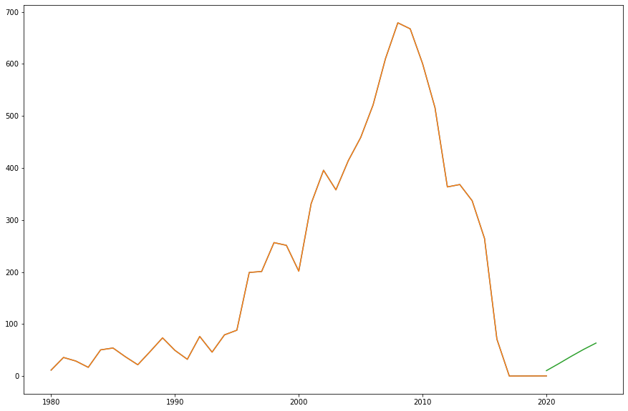
Past sales including 5-year forecast, predicting a comeback in sales

Slide 13
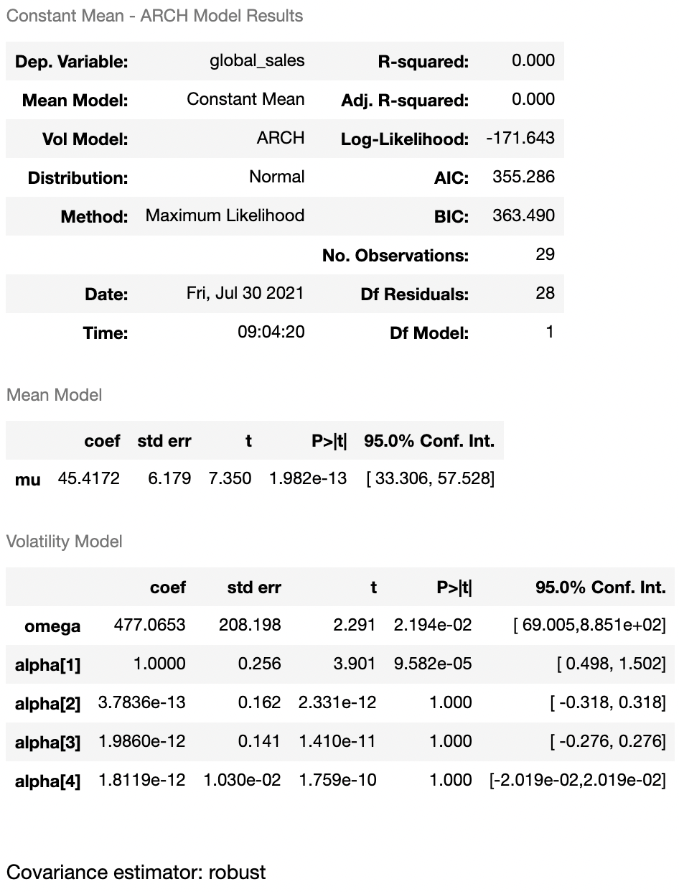
ARCH Model
Judging from the high Log-Likelihood value, this model is a relatively good fit. Combined with the fact that all of our mean and volatility coefficients were significant, this model should be able to reliably predict future variance.

Slide 14
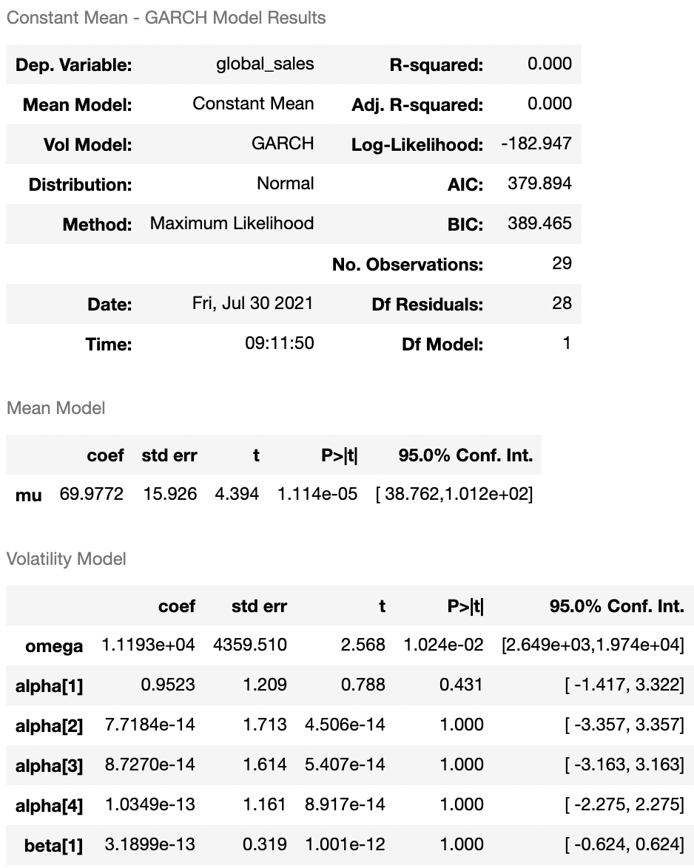
GARCH Model The Loglikelihood of the GARCH model is slightly less than the ARCH alternative, making it a worse fit. Due to a relatively small amount of data, ARCH is the more appropriate model to use because of the complexity for which the GARCH model typically accounts.

Slide 15
Takeaways
The conclusions that I draw from my analysis of video game sales over the past 40 years are that while the market suffered a dip over the last decade, it will likely turn back to reflect growth.
The data also suggests a significant level of volatility in future sales.

Slide 16
Future Research
For the next project, I would like to get a much bigger dataset of sales to work with, down to month/week/daily sales. Only having annual sales, I obviously was not able to examine seasonal trends, just the long-term growth and decay.
It would also be interesting to look at other media sales’ performance over the last decade and see whether there is any correlation between sets of data.

